Slide 1
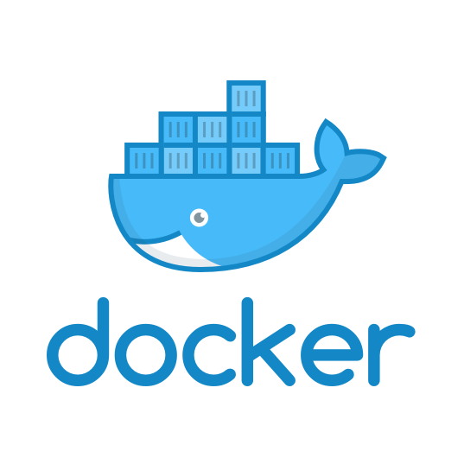
Docker Workshop

Slide 2
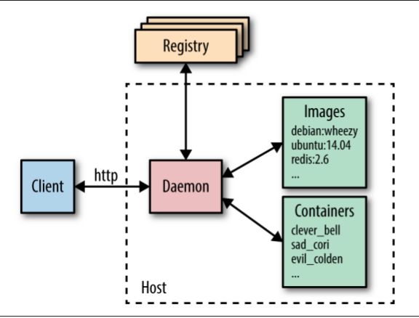
wt is docker?
i.e: hub.docker.com
Docker client is used to talk to
the Docker daemon via HTTP.
but it can also use a TCP socket
to enable remote clients or a file
descriptor for systemd-
managed sockets.
Docker daemon - is responsible for:
creating, running, monitoring containers
building, storing images

Slide 3
Installing docker
Linux – no problem (:
MacOS, see requirements.
Docker for Mac requires OS X El Capitan 10.11 or newer macOS release running on a 2010 or newer Mac, with Intel’s hardware support for MMU virtualization
https://docs.docker.com/docker-for-mac/

Slide 4
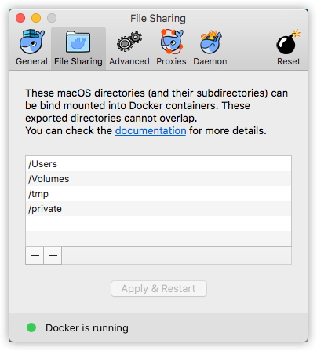
MacOS specific
Decide which directories on your Mac to share with containers.
There are some limitations on the directories that can be shared:
They cannot be a subdirectory of an already shared directory.
They cannot already exist inside of Docker.

Slide 5
docker run hello-world
Hello from Docker!
This message shows that your installation appears to be working correctly.
To generate this message, Docker took the following steps:
...(snipped)...
This will setup a basic ‘hello-world’ container, pulled from docker images repo,
located @ https://hub.docker.com

Slide 6
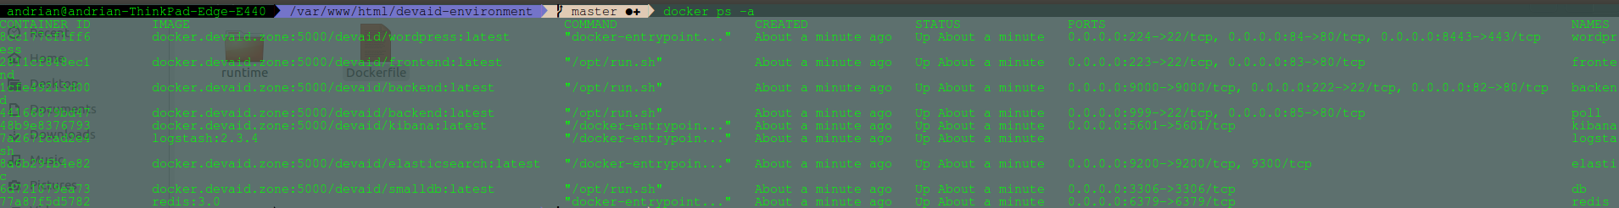
docker ps -a
Display all local containers

Slide 7
docker rm -f $(docker ps -aq)
Kill all containers

Slide 8
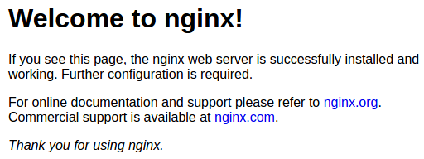
docker run -dP nginx
Runs a container in detached(background) mode
hit once again:
docker ps -a
CONTAINER ID IMAGE COMMAND CREATED STATUS PORTS NAMES
ba692fc95604 nginx "nginx -g 'daemon ..." 2 seconds ago Up 2 seconds 0.0.0.0:32774→80/tcp happy_hopper
in browser hit localhost:{exposed port}

Slide 9
docker exec -it `image_id` bash
Enter in a container image with an interactive pseudo-TTY
inside container: nginx -v
!NOTE: SSH daemon
Images do not install or run an SSH daemon by default. The normal way of getting a shell is to use the docker exec command.

Slide 10
building images from Dockerfiles
Dockerfile is simply a text file that contains a set of steps that can be used to create a Docker image
FROM python:3.4
WORKDIR /usr/src/app
RUN pip install Flask==0.12 flask-restful==0.3.5
COPY . /usr/src/app
EXPOSE 80
CMD [ "python", "api.py" ]

Slide 11
docker build . --tag pyt:1
An image is build(compiled) with a certain name:tag
Sending build context to Docker daemon 4.096kB
Step 1/6 : FROM python:3.4
---> 1306ea7c055d
Step 2/6 : WORKDIR /usr/src/app
---> Using cache
---> cb98081b8997
Step 3/6 : RUN pip install Flask==0.12 flask-restful==0.3.5
---> Using cache
---> a4ff0b56fce1
Step 4/6 : COPY . /usr/src/app
---> 9e53e7ab8e12
***********
Removing intermediate container a1845443ce7e
Successfully built 831965bfb055
Successfully tagged pyt:1

Slide 12
docker run --name spyt -dP pyt:1
A Docker image gets run under a certain id: 613635329c34a62f1665a6dfbdd2cc227e89efb380961c2aeb927e3ddf61c112
with a name: spyt
Image name is unique, one can run another pyt:1 image instance but with another image name.
docker run --name spyt_1 -dP pyt:1
docker ps -a
Should show up 2 instances of pyt:1 with different names

Slide 13
Try editing api.py file
Response didn’t change.
That’s because the docker image has built a snapshot that is independent from our local one.
To modify it’s ‘guts’ one has to enter in container, and work from there.
We need this stuff synced, so it can be developed, no?

Slide 14
Managing data in containers
A data volume is a specially-designated directory within one or more containers that bypasses the Union File System. Data volumes provide several useful features for persistent or shared data:
  Volumes are initialized when a container is created. If the container’s base image contains data at the specified mount point, that existing data is copied into the new volume upon volume initialization. (Note that this does not apply when mounting a host directory.)
  Data volumes can be shared and reused among containers.
  Changes to a data volume are made directly.
  Changes to a data volume will not be included when you update an image.
  Data volumes persist even if the container itself is delete

Slide 15
automate with Compose
There’s a final bit of automation we can add to make things a bit simpler.
Docker Compose is designed to quickly get Docker development environments up and running.
Essentially, it uses YAML files to store the configuration for sets of containers, saving developers from repetitive and error-prone typing or rolling their own solution.
Our application is so basic that it doesn’t buy us much at the moment, but it will quickly come into its own as things get more complicated.
Compose will free us from the need to maintain our own scripts for orhcestration.

Slide 16
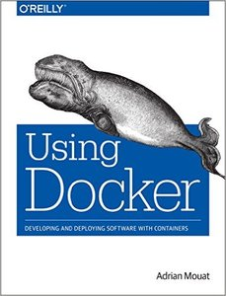
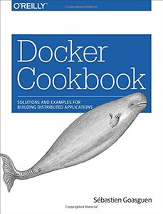
what to read
allitebooks.com/docker-cookbook
allitebooks.com/using-docker

Slide 17

Good luck using docker (:

